Slide 1

Portfolio Optimization
Using Deep Learning Techniques.
GROUP 5
VAIBHAV VIKAS GAIKWAD
MIHIR NILESH HOLMUKHE
SUKHAD DNYANESH JOSHI
BISWADIP BISWANATH

Slide 2
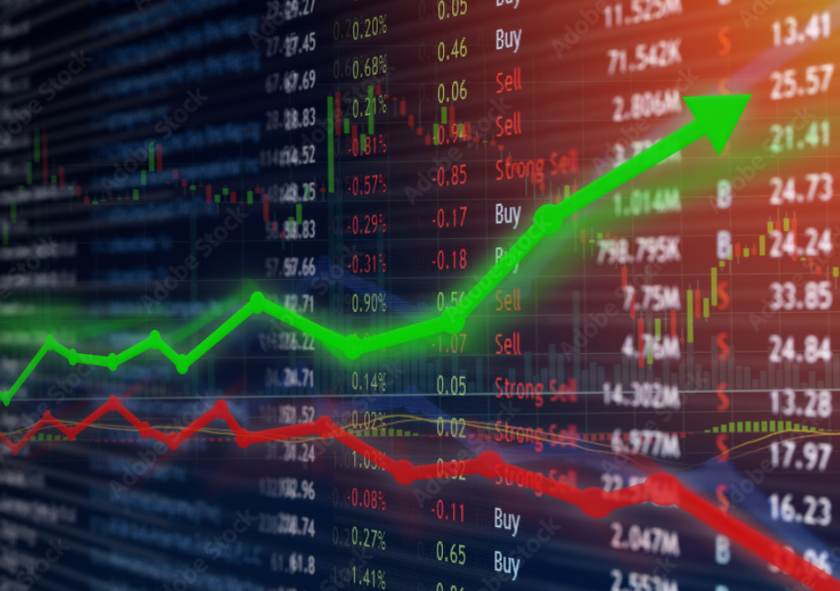
PROJECT OVERVIEW
This project explores portfolio optimization using deep learning, combining CNNs with LSTMs to analyze this trend over time.
Together, these techniques offer a better way to analyse financial data, predict market movements, and create more effective portfolios. This project aims to provide a fresh perspective on portfolio optimization, helping investors make smarter decisions in a fast-changing market.
Unlike traditional methods like Mean-Variance Optimization, this approach models complex market dynamics and predicts asset price movements more effectively. Using data from the Yahoo Finance, the goal is to help investors create smarter, more adaptive portfolios in a rapidly changing market.

Slide 3

PROJECT GOALS
Stock
Stock Price Prediction: Accurately forecast daily stock prices, including key metrics such as opening, high, low, adjacent closing prices, to support informed investment decisions.
Pattern
Pattern Discovery: Uncover complex relationships and dependencies among stocks to gain deeper insights into factors influencing portfolio performance.
Leverage
Dynamic Portfolio Optimization: Leverage deep learning techniques to construct portfolios that maximize returns while minimizing risk by capturing both short-term fluctuations and long-term market trends.
Employ
Data-Driven Insights: Employ advanced visualization techniques to highlight data trends, reveal patterns, and evaluate model accuracy, providing a clear and actionable understanding of the optimization process.

Slide 4
DATA EXPLORATION
Data Source and Features:
Source: Yahoo Finance Stock Tickers: AAPL (Apple Inc.), TSLA (Tesla Inc) Date Range: January 1, 2024 – November 30, 2024
Features:
Date: Used as the index for the time series dataset.
Open: The opening price of the stock on each trading day.
High: Highest price reached during the trading day, reflecting price spikes and volatility.
Low: Lowest price reached during the trading day, complementing the High to capture the trading range.
Close: Closing price at the end of each trading day, indicating the stock's final value.
Adj Close: Adjusted closing price, accounting for corporate actions like splits and dividends, to provide the most accurate price data.
Volume: Number of shares traded during the day, indicating market activity and liquidity.

Slide 5
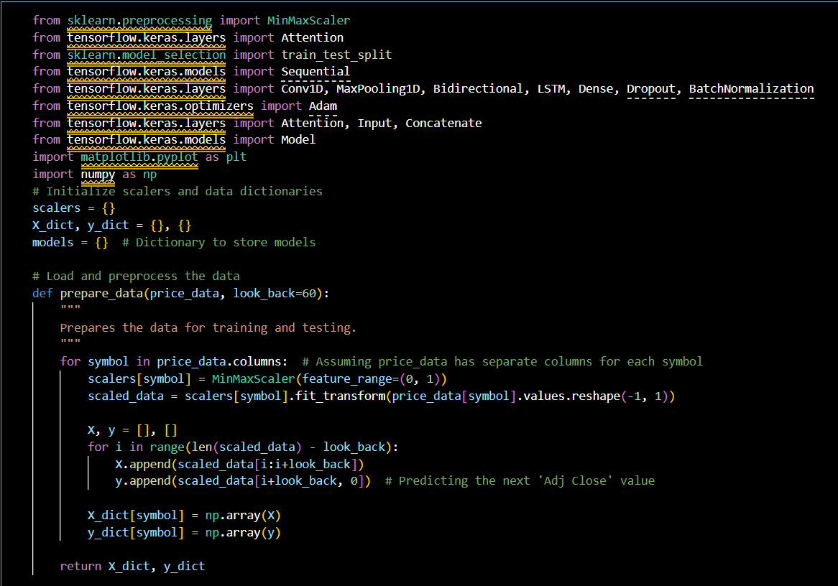
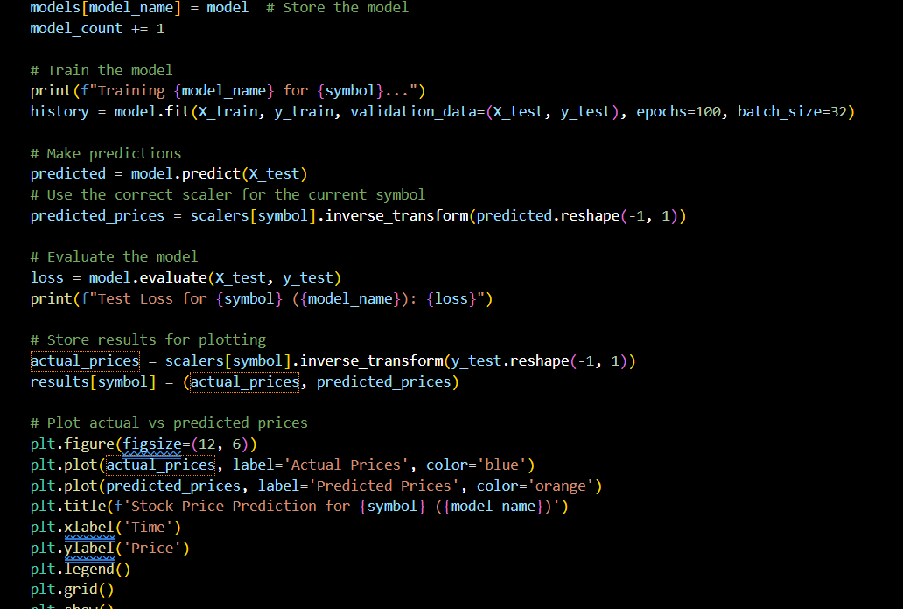
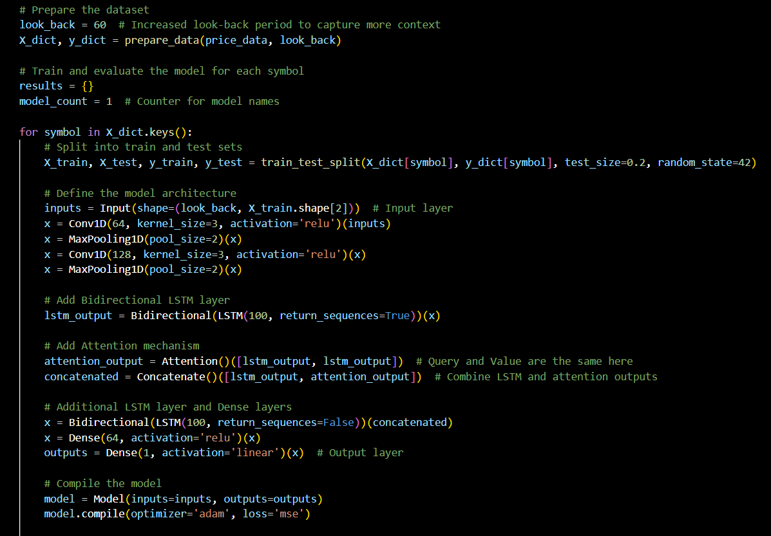
METHODOLOGY.
Data Preparation:
Each stock's price data is normalized using MinMaxScaler.
A sliding window approach (look_back = 60) creates sequences of 60 data points to predict the next price.
Data Splitting:
The prepared data is divided into training and testing sets (80/20 split) for each stock symbol.
Model Architecture:
Input Layer: Accepts sequences of stock data.
Feature Extraction: Two stacked Conv1D layers with max-pooling to extract temporal features.
Sequence Modeling: A Bidirectional LSTM layer processes sequential dependencies.
Attention Mechanism: Highlights relevant parts of the sequence by combining the LSTM output with attention weights.
Training:
Each stock has its unique model trained using Adam optimizer and mean squared error (MSE) loss for 200 epochs with a batch size of 32.
Prediction and Evaluation:
Predictions are inverse-transformed back to the original scale for comparison.
The models' performance is evaluated using MSE, and results (actual vs. predicted prices) are plotted.
Storage and Visualization:
Models are named dynamically and stored in a dictionary.
Plots visualize the actual vs. predicted prices to assess model performance visually for each stock symbol.

Slide 6
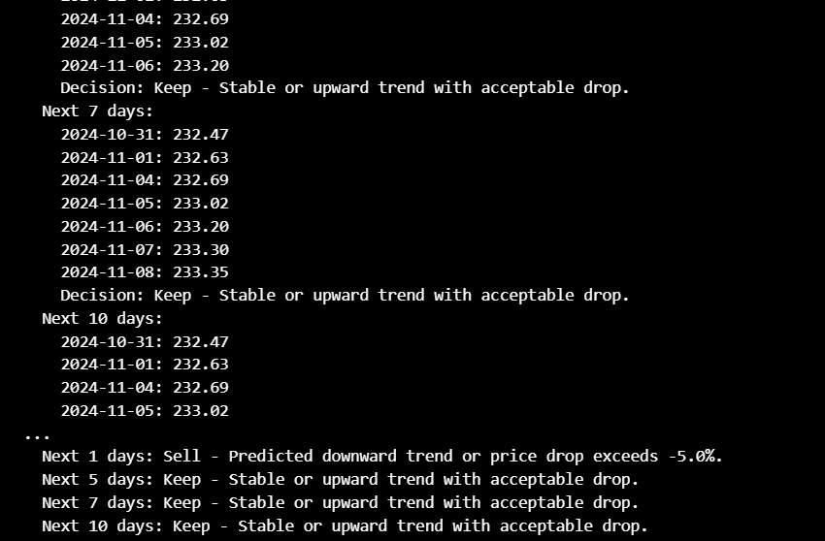
THE DECISION-MAKING PROCESS.
Purpose: Decide whether to "Keep" or "Sell" a stock based on future price predictions.
Logic:
Check if the predicted trend is "upward" or "downward."
Evaluate the maximum potential drop in price compared to the current price.
If the trend is downward or the drop exceeds -5%, recommend "Sell." Otherwise, recommend "Keep."
Implementation:
For each stock, evaluate predictions for the next few days.
Store decisions with reasons (e.g., "Predicted downward trend" or "Acceptable drop").
Output:
Detailed decisions for each stock, including predictions, "Keep" or "Sell," and reasoning.
A summary for quick review.

Slide 7
MODEL SELECTION.

Slide 8
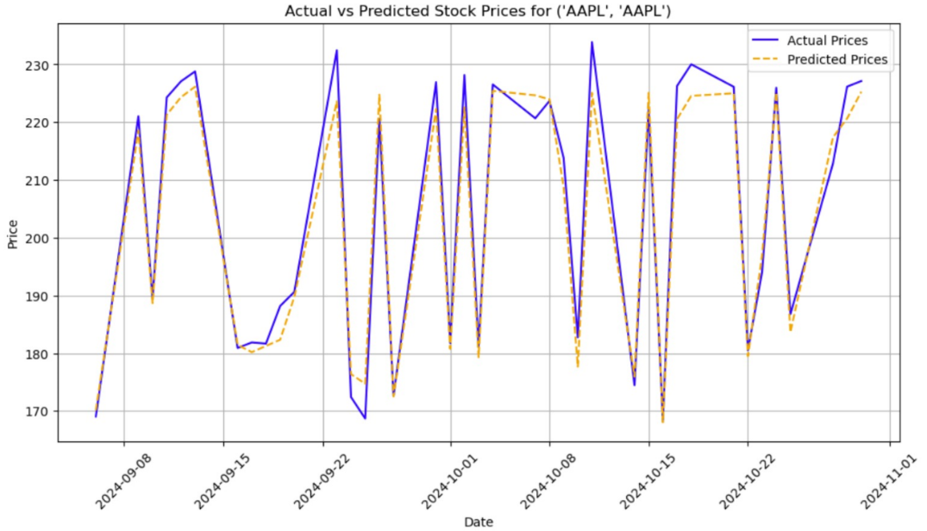
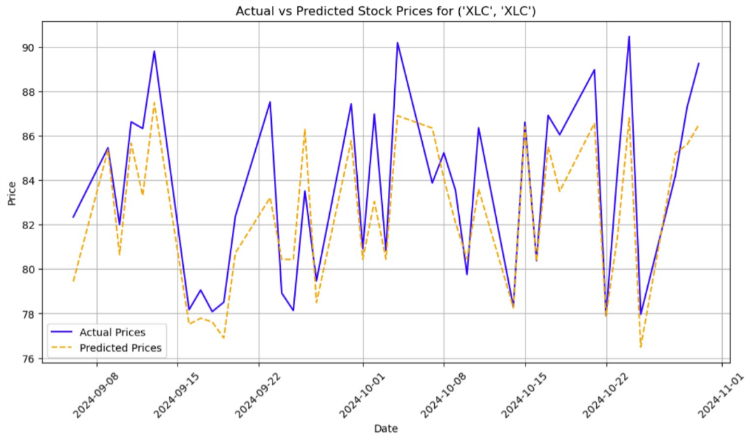
RESULTS
THE LINE GRAPHS

Slide 9
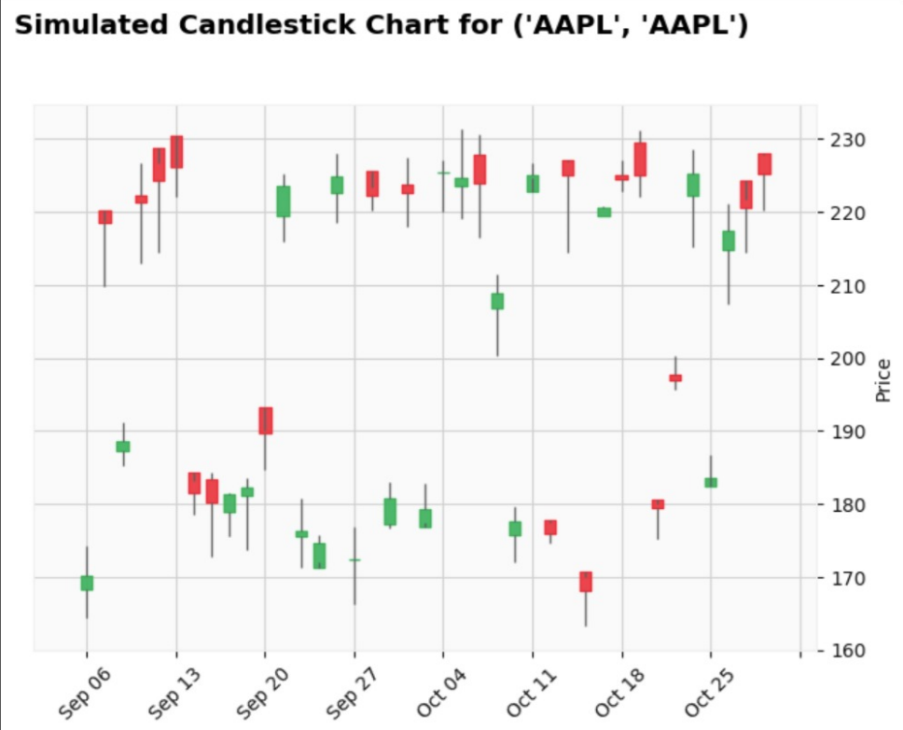
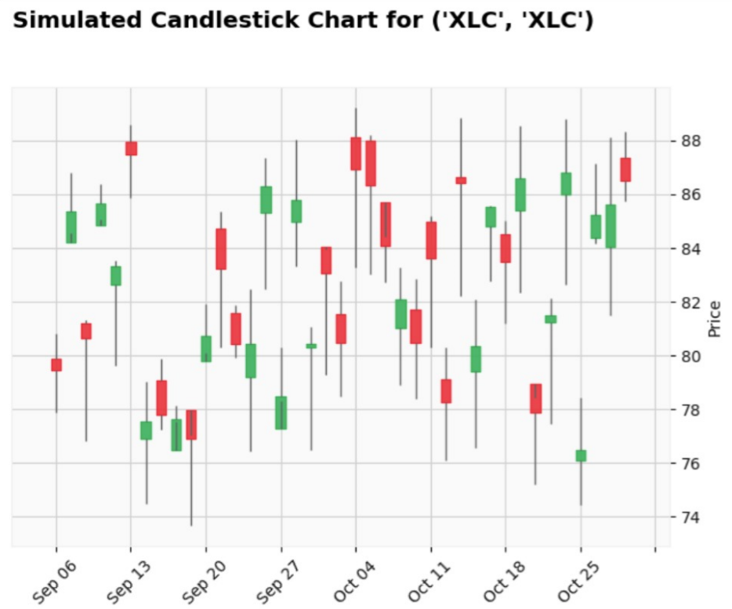
THE CANDELSTICK CHART

Slide 10
CHALLENGES FACED
Data Gaps:
Financial data from Yahoo Finance sometimes includes missing or NaN values for certain dates or specific stock tickers. This can occur due to market holidays, incomplete data updates, or API limitations. For example, during weekends or public holidays, the stock market is closed, resulting in missing data points.
High Market Volatility Problem:
Financial markets are highly volatile, making it challenging for the model to generalize. Sudden price spikes or drops caused by specific events or announcements introduce noise in the data.
Overfitting Problem:
Due to the limited size of the dataset (e.g., daily prices for less than a year), the model risked overfitting, particularly with complex architectures like CNN-LSTM. Overfitting was evident when the model performed well on the training data but poorly on the test set.

Slide 11
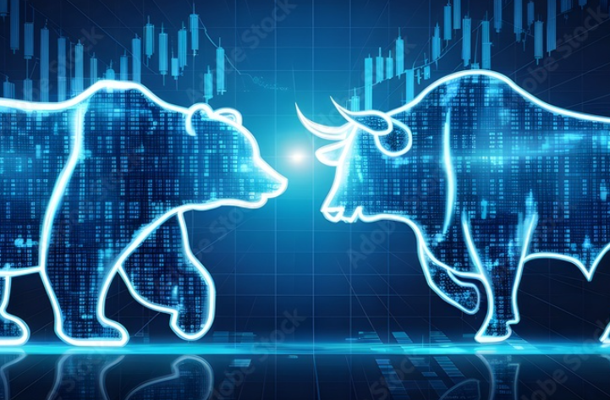
CONCLUSION
In this project, we successfully implemented deep learning techniques to optimize stock portfolio management. By leveraging Conv1D layers, Bidirectional LSTMs, and attention mechanisms, we created a robust model capable of predicting stock prices and guiding investment decisions. The decision-making framework provided actionable insights by recommending "Keep" or "Sell" based on predicted trends and potential price drops.
While we faced challenges in handling data volatility and ensuring model accuracy, these obstacles provided valuable learning opportunities, enhancing our understanding of real-world stock behavior. The results, reflected in visualizations and predictions, demonstrate the potential of deep learning in financial analytics.
This project lays the foundation for future enhancements, such as integrating additional data sources (e.g., market sentiment or economic indicators) and exploring more advanced models for improved performance. Overall, our approach shows promise for data-driven portfolio management, making investment strategies more informed and reliable.

